Slide 1
Topic: Measurement
EQ: How do I use formulas to calculate the surface area of solid sectors?

Slide 2
Learning Intentions
Students will be able to
- Calculate the surface area of solid sectors from a given diagram.
- Interpret a familiar worded question to draw a diagram, and calculate the surface area of solid sectors.

Slide 3
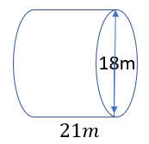
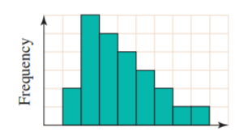
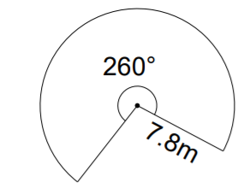
Starter – Daily 5 (sorry only 4!!)
Calculate the SA of the following cylinder.
2. Describe the shape of the distribution of the following data in the histogram
3. Two coins are flipped. If this is performed 20 times, what is the expected number of times that both coins would show tails?
4. Calculate the area of this sector

Slide 4

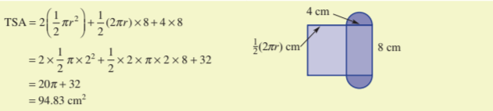
24
7
30
Topic: Measurement
Date:
EQ: How do I use formulas to calculate the surface area of solid sectors?
The sector area rule A = $\frac{\text{θ}}{\text{360}}$ × π$r^{2}$can be applied to find the surface areas of solids which have ends that are sectors.

Slide 5
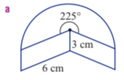
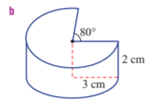
24
7
30
Topic: Measurement
Date:
EQ: How do I use formulas to calculate the surface area of solid sectors?
Let’s try another one together: Find the surface area of these 2 solid sectors

Slide 6
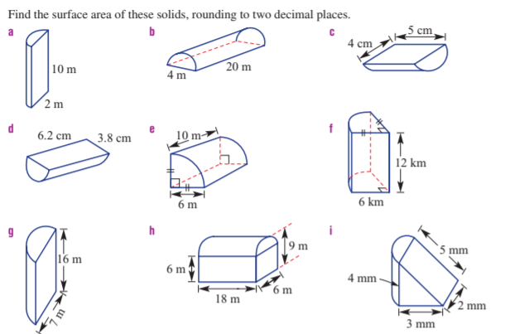
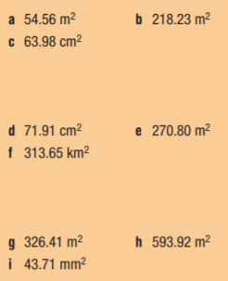
24
7
30
Topic: Measurement
Date:
EQ: How do I use formulas to calculate the surface area of solid sectors?

Slide 7


24
7
30
Topic: Measurement
Date:
EQ: How do I use formulas to calculate the surface area of solid sectors?
Worded question

